Slide 1
MUST Graduate Application Forum
- Progress Report 2
Group members: He Xinyi, Cao Yulong, Chen Rui, Lu Jie

Slide 2
Contents
01 | Sprint 2 Progress
02 | Source code
03 | Project Management Process
04 | Challenges Encountered in JIRA+Scrum

Slide 3
01 | Sprint 2 Progress
Workflow
Active Sprints
Release – Version 2.0
Sprint 2 User Stories

Slide 4
3 Sprints
Sprint 2
Main Page
Registration
Sprint 1
Sprint 3
Receive Feedbacks
Login Page
Post Text
Separation of Login Page and Registration Page
Change Personal Information
Searching by Keywords
Searching by Tags
(Environment Setting & Database Setting)
Make Comments
Account Management
Session cookie
Give a like

Slide 5
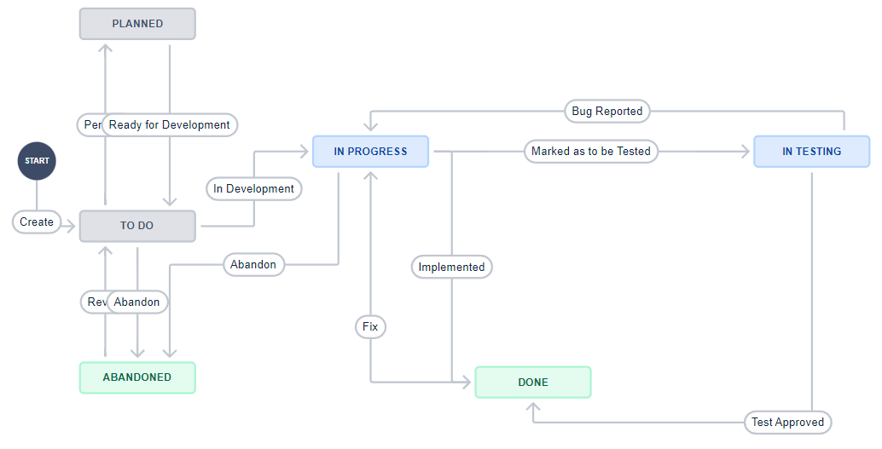
Workflow

Slide 6
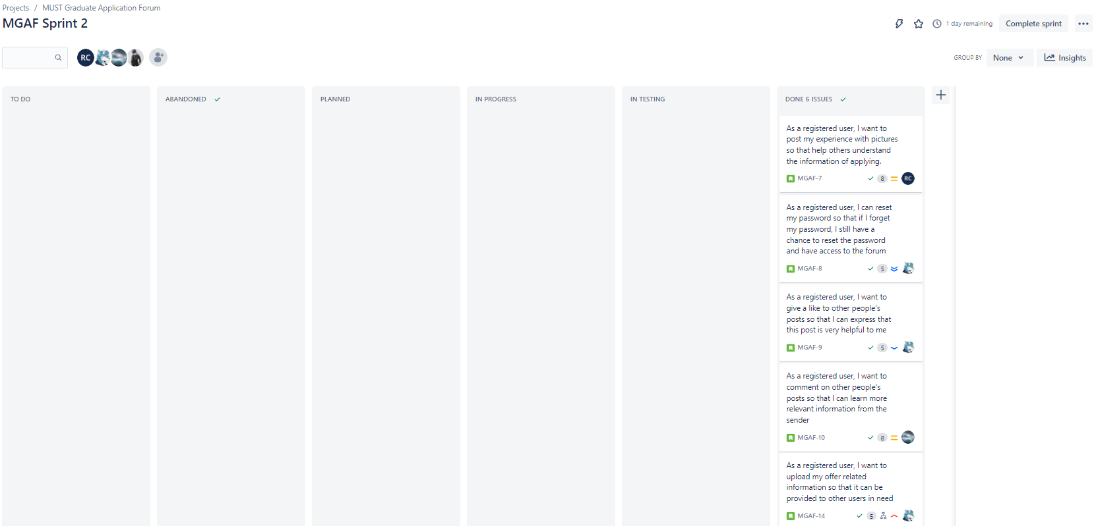
Active Sprints

Slide 7
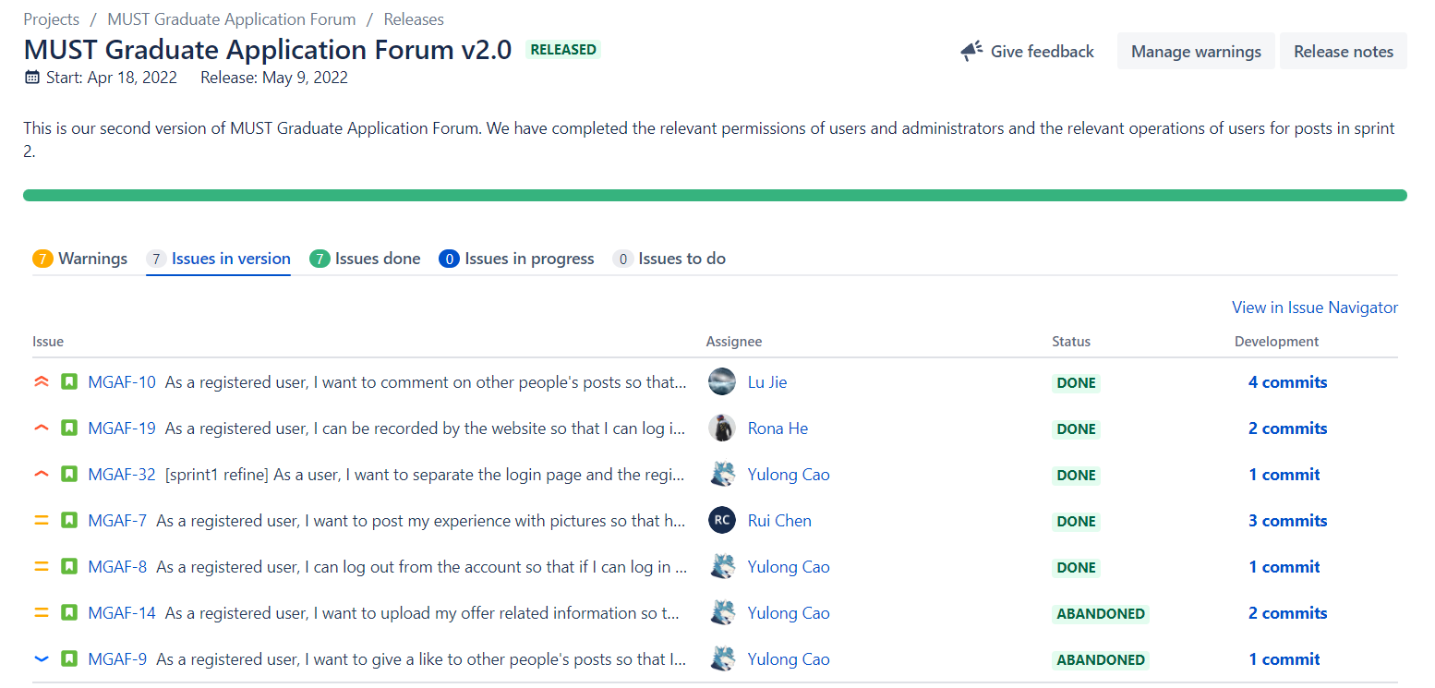
Release – Version 2.0

Slide 8
Sprint 2 - User Stories We Have Done
1. Separation of Login Page and Registration Page
[sprint1 refine] As a user, I want to separate the login page and the registration page so that I can correctly select the operation I want to perform.
2. Make Comments
As a registered user, I want to comment on other people's posts so that I can learn more relevant information from the sender
3. Account Management
As a registered user, I can log out from the account so that if I can log in again with other accounts
4. Session Cookie
As a registered user, I can be recorded by the website so that I can log in automatically if I accidentally close the browser

Slide 9
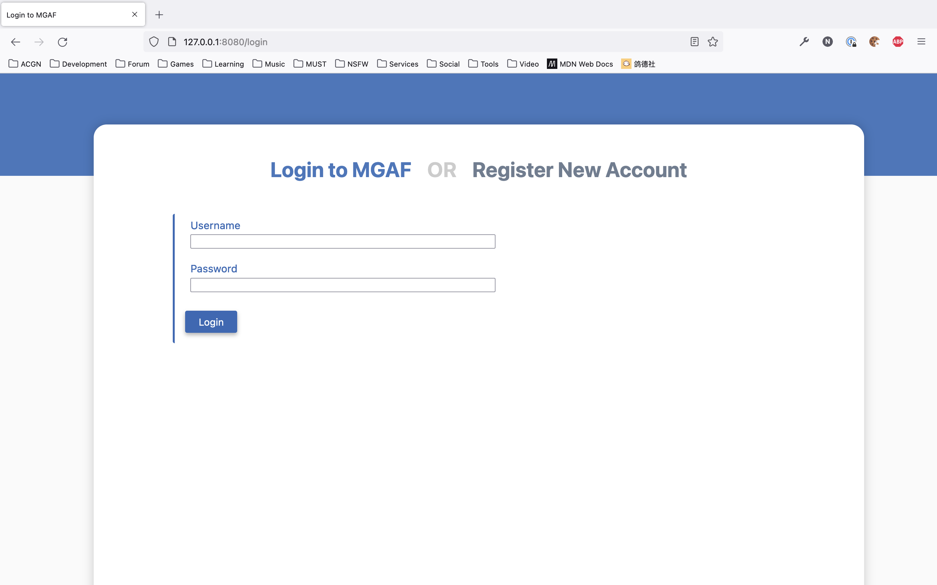
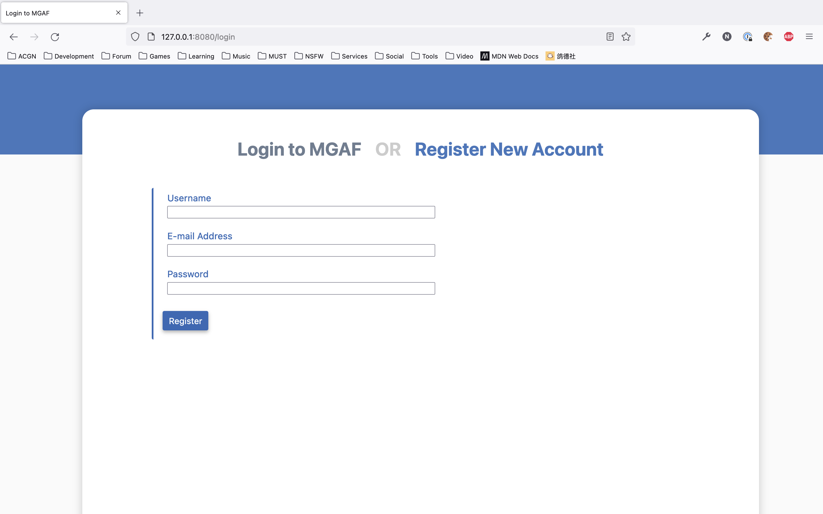
Sprint 2 - User Stories We Have Done
1. Separation of Login Page and Registration Page
[sprint1 refine] As a user, I want to separate the login page and the registration page so that I can correctly select the operation I want to perform.

Slide 10
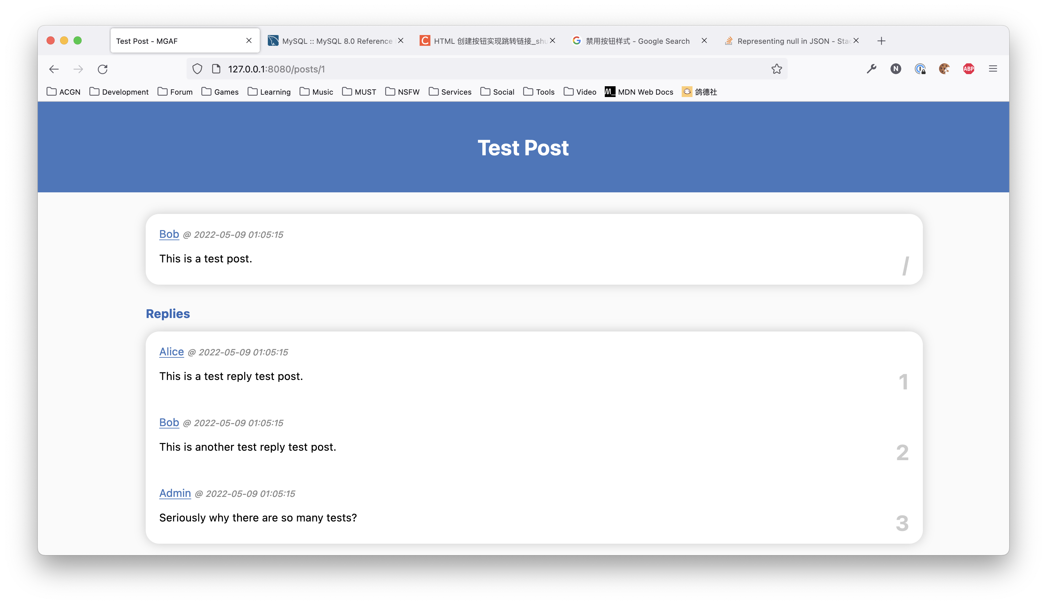
Sprint 2 - User Stories We Have Done
2. Make Comments
As a registered user, I want to comment on other people's posts so that I can learn more relevant information from the sender

Slide 11
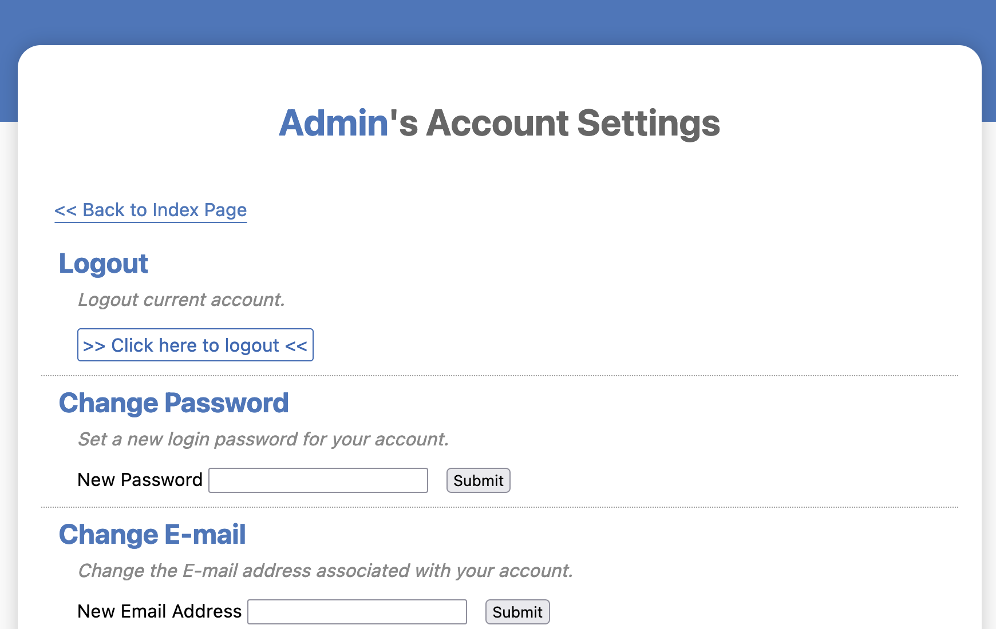
Sprint 2 - User Stories We Have Done
3. Account Management
As a registered user, I can log out from the account so that if I can log in again with other accounts

Slide 12
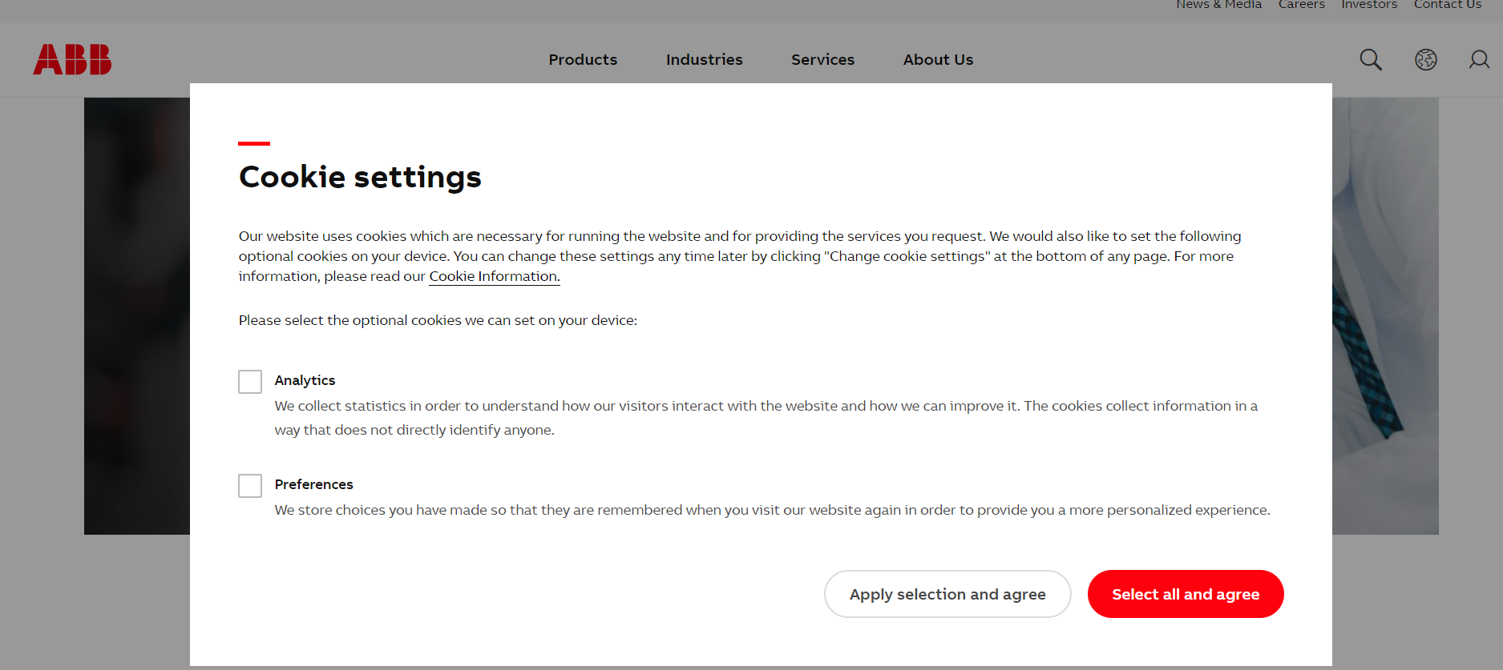
4. Session cookie – Resolving stateless problem
As a registered user, I can be recorded by the website so that I can log in automatically if I accidentally close the browser
https://global.abb/group/en

Slide 13
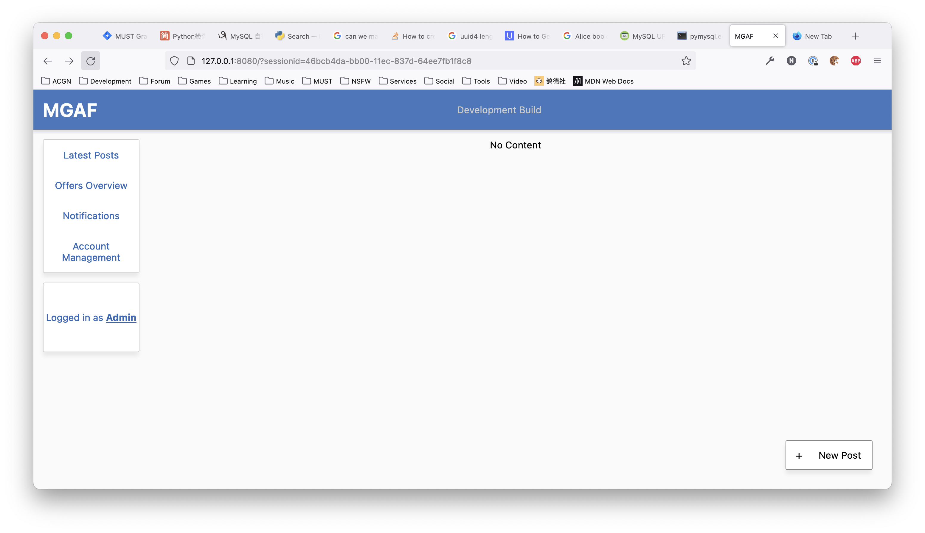
4. Session cookie - Security
Former
Now

Slide 14
02 | Source Code

Slide 15
03 | Project Management Process
Burndown chart
Burnup chart
Sprint report
Velocity report

Slide 16
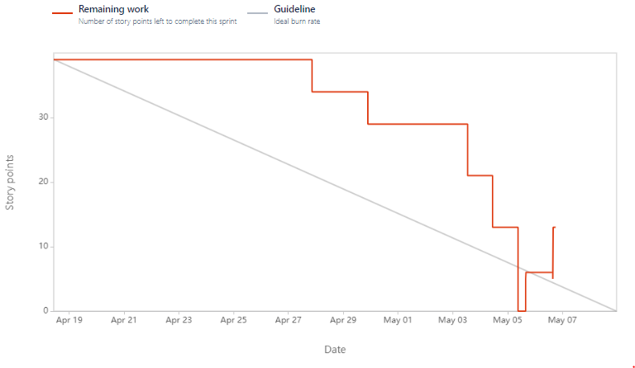
Burndown Chart
Red line: Number of story points left to complete in sprint 2.
Completed on May 6th.
Fluctuations
Burndown Chart

Slide 17
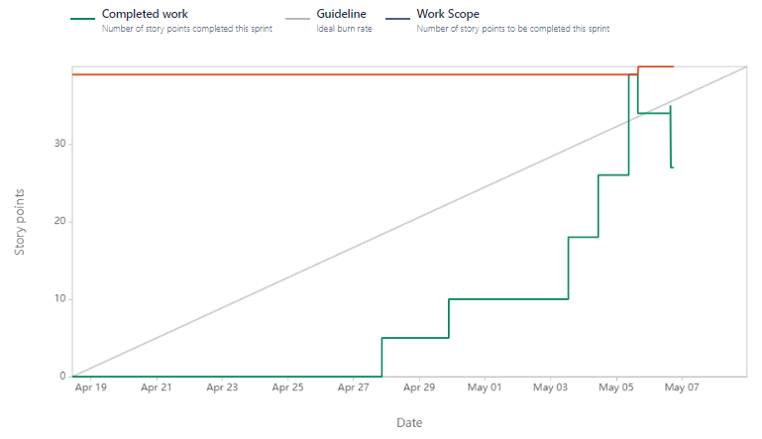
Burnup Chart
Red line: Number of story points to be completed in sprint 2.
Green line: Story points completed in sprint 2.
Confluence point: Completed 27 story points, 7 issues before May 6th.
Burnup Chart

Slide 18
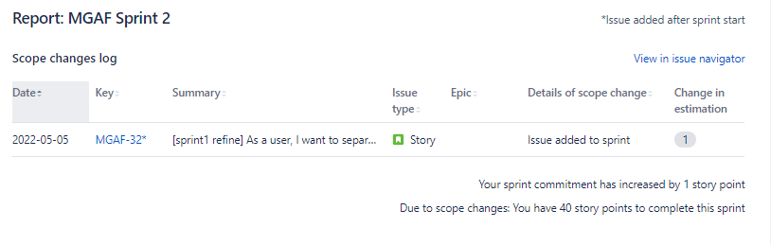
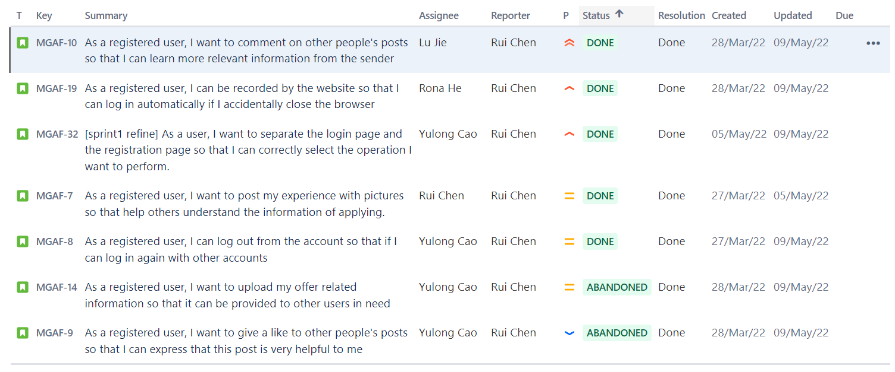
Sprint Report
Issue information:
Issue date, key, type, summary, scope changes
Completed issues
Incomplete issues
Sprint Report

Slide 19
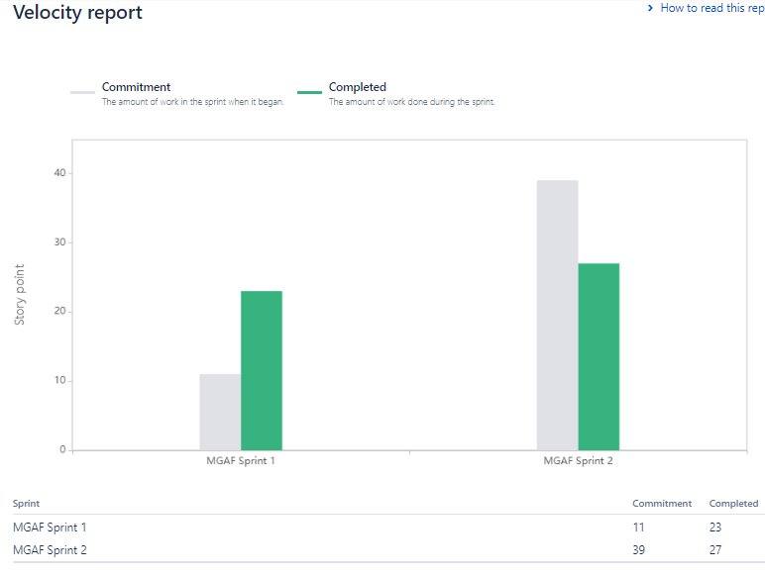
Velocity Report
Green column: The number of work done in sprint 2.
Total commitment: 39
Total completed: 27
Velocity Report

Slide 20
04 | Challenges Encountered in JIRA+Scrum

Slide 21
We only divided issues by the function presented
→ Difficult for us to track the implementation of each small function
→There are some issues taking relatively long time
The way to solve: divide each issue more carefully in the subsequent sprint.
We forget to create another issue for the issue that need improvement in sprint1
→ Lack JIRA related management on this part
The way to solve: confirm what new features we need and is there any room for improvement of previous issues

Slide 22
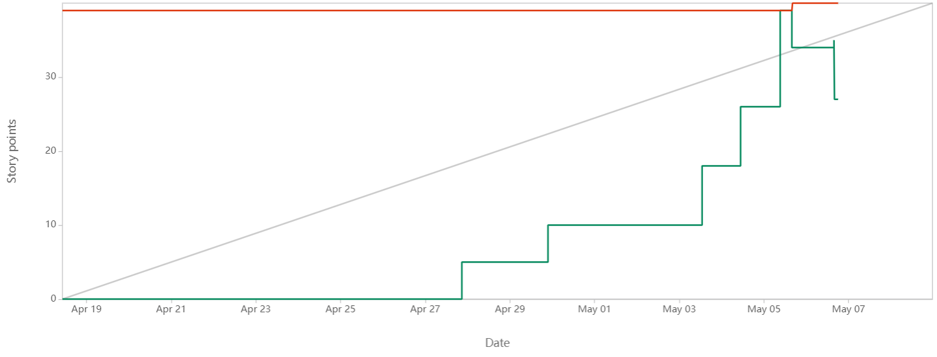
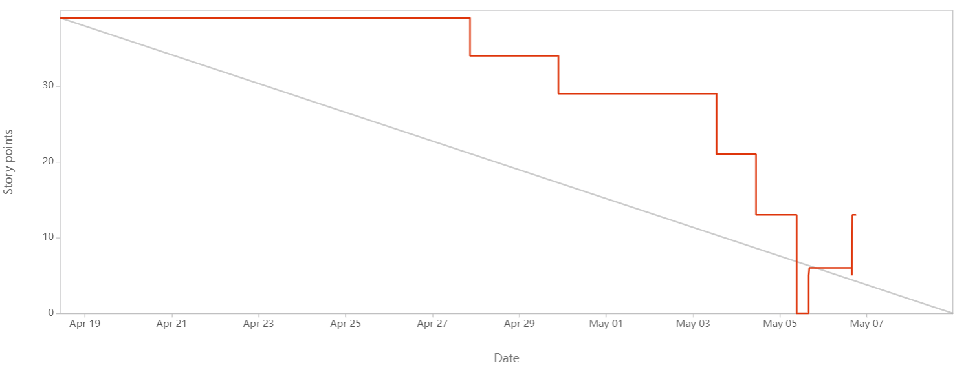
We lacked consideration of other factors that might exist when we allocated time
→ A lot of work is delayed, the report represents slow before fast, loose before tight
The way to solve: consider some realities when allocating time in the next sprint.

Slide 23
4. There are some difficulties when we complete Sprint2.
The way to solve: change issues from “abandoned” into “done”

Slide 24
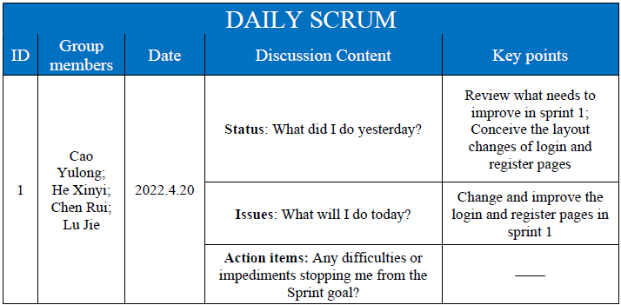
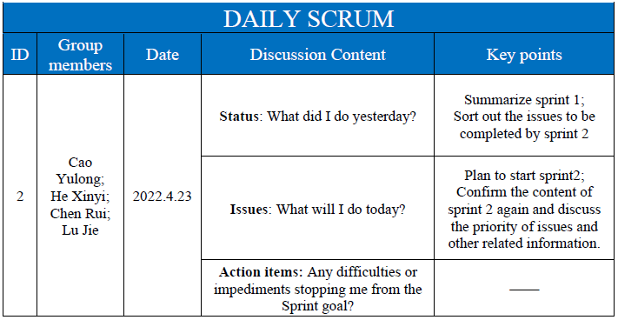
Daily scrum

Slide 25
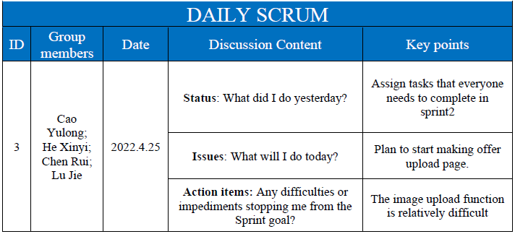
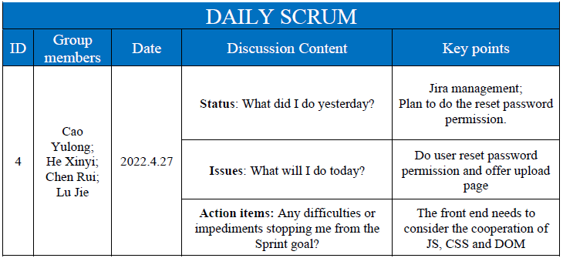
Daily scrum

Slide 26
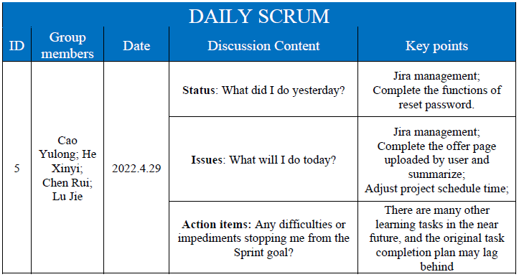
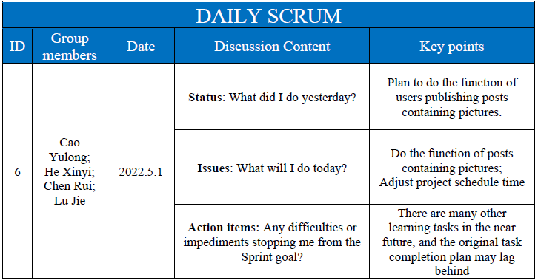
Daily scrum

Slide 27
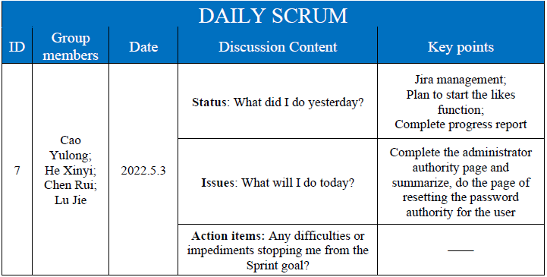
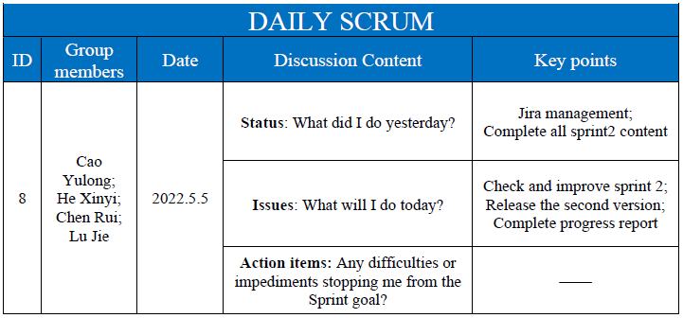
Daily scrum

Slide 28
References
Jira productors. (2018, January 9). Jira Documentation, from Jira Documentation: https://confluence.atlassian.com/jira
Erica Chappell. (2020, February 21). What’s A Burn Up Chart & How Do You Use It, from What’s A Burn Up Chart & How Do You Use It: https://clickup.com/blog/burn-up-chart/
Team Asana. (2021, October 11). Burndown chart: What it is and how to use it, from Burndown chart: What it is and how to use it: https://asana.com/resources/burndown-chart
David Lowe. (2017, May 15). Sprint Reports, from Sprint Reports: https://scrumandkanban.co.uk/sprint-reports/
David Lowe. (2022, Feburary 4). Velocity report, from Velocity report: https://docs.microsoft.com/en-us/previous-versions/azure/devops/report/sqlreports/velocity?view=tfs-2017
Caitlin Mackie. (2020, December 15). What is the difference between sprints and versions in Jira, from What is the difference between sprints and versions in Jira: https://www.easyagile.com/blog/sprints-versions-jira/
Luke Harrison. (2021, December 21). How to Create a Forum Website, from How to Create a Forum Website: https://websitesetup.org/create-a-forum-website

Slide 29
Thanks for listening!

